Slide 1
An Automotive Application of the Organic Rankine Cycle for Power Generation Using Recovered Waste Heat
Glenn Clapp
Masters project collaboration between
Grand Valley State University & GHSP

Slide 2
Outline
Waste heat recovery
Sources
Recovery techniques
Technical hurdles
Thermodynamic cycles
Rankine cycle
Organic Rankine cycle
Kalina cycle
Automotive application
Special design considerations
Heat sources
Iterative design
Cycle parameters
Design space
Mathematical modelling
Optimization
Results
Design specifications
Assumptions
Discussion
Conclusion

Slide 3
Outline
Waste heat recovery
Sources
Recovery techniques
Technical hurdles
Thermodynamic cycles
Rankine cycle
Organic Rankine cycle
Kalina cycle
Automotive application
Special design considerations
Heat sources
Iterative design
Cycle parameters
Design space
Mathematical modelling
Optimization
Results
Design specifications
Assumptions
Discussion
Conclusion

Slide 4
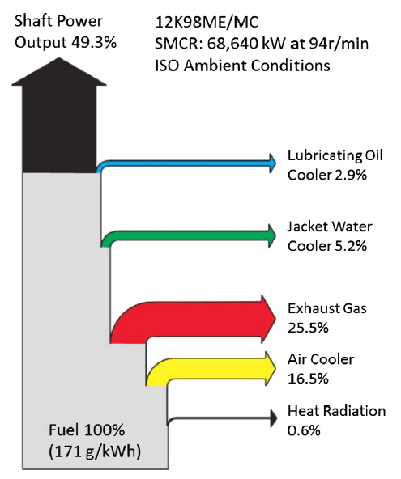
Waste heat recovery source
This diagram shows a common breakdown of waste heat from an engine. Note that less than half of the power originally contained in the fuel produces useful work.
Automotive applications typically convert even lower percentages of power from the energy in fuel into useful work.

Slide 5
Waste heat recovery source
The remaining energy fractions are considered waste heat. The energy from the fuel is converted into heat which is managed by vehicle systems, or escapes into the vehicle’s environment.
It is the goal of this project to harness this waste heat energy to increase the percentage of energy from fuel that does useful work.

Slide 6
Outline
Waste heat recovery
Sources
Recovery techniques
Technical hurdles
Thermodynamic cycles
Rankine cycle
Organic Rankine cycle
Kalina cycle
Automotive application
Special design considerations
Heat sources
Iterative design
Cycle parameters
Design space
Mathematical modelling
Optimization
Results
Design specifications
Assumptions
Discussion
Conclusion

Slide 7
Waste heat recovery techniques
Cogeneration
Kinetic energy recovery
Electricity generation

Slide 8
Waste heat recovery techniques
Cogeneration:
Cogeneration is also referred to a combined heat and power (CHP). In a process that meets this description, electricity and useful heat are generated at the same time.
This is the most efficient and technically simple method of harvesting waste heat. The process is simply designed so that the heat generated while generating power is directly useful for some other process on site. It is essentially no longer waste.

Slide 9
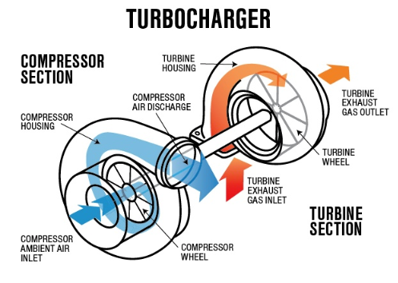
Waste heat recovery techniques
Kinetic energy recovery:
One example of kinetic energy recovery is that of the “turbocharger” which is driven by the exhaust gases from the engine to force extra compressed air into the combustion chamber and improve engine efficiency.

Slide 10
Waste heat recovery techniques
Electricity generation:
Electricity generation is the least efficient form of waste heat recovery. Most techniques involve the use of waste heat to generate steam or some other vapor, which drives a turbine or similar device which actuates an electric generator.
This type of waste heat recovery is the subject of this project.

Slide 11
Outline
Waste heat recovery
Sources
Recovery techniques
Technical hurdles
Thermodynamic cycles
Rankine cycle
Organic Rankine cycle
Kalina cycle
Automotive application
Special design considerations
Heat sources
Iterative design
Cycle parameters
Design space
Mathematical modelling
Optimization
Results
Design specifications
Assumptions
Discussion
Conclusion

Slide 12
Technical hurdles
Temperature of waste heat
Heat quality
Collection
Fouling
Technical complexity
Diminishing returns

Slide 13
Outline
Waste heat recovery
Sources
Recovery techniques
Technical hurdles
Thermodynamic cycles
Rankine cycle
Organic Rankine cycle
Kalina cycle
Automotive application
Special design considerations
Heat sources
Iterative design
Cycle parameters
Design space
Mathematical modelling
Optimization
Results
Design specifications
Assumptions
Discussion
Conclusion

Slide 14
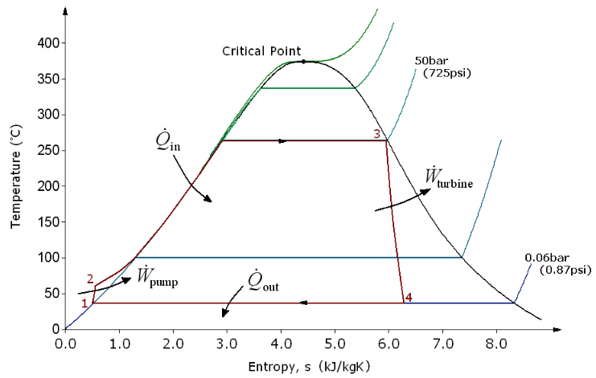
Traditional Rankine cycle
Process 1 -> 2: The working fluid is pumped from low to high pressure in the liquid state.
Process 2 -> 3: The high-pressure working fluid is heated at a constant pressure to a saturated vapor.
Process 3 -> 4: The saturated vapor expands through a turbine. Temperature and pressure decrease.
Process 4 -> 1: The wet vapor condenses into a saturated liquid at a constant pressure

Slide 15
Outline
Waste heat recovery
Sources
Recovery techniques
Technical hurdles
Thermodynamic cycles
Rankine cycle
Organic Rankine cycle
Kalina cycle
Automotive application
Special design considerations
Heat sources
Iterative design
Cycle parameters
Design space
Mathematical modelling
Optimization
Results
Design specifications
Assumptions
Discussion
Conclusion

Slide 16
Organic Rankine cycle
The organic Rankine cycle is the same exact cycle in practice. The only difference is the working fluid. In the organic Rankine cycle working fluids with low phase transition temperatures, such as hydrocarbons and refrigerants, are chose. The are “organic molecules.”
Organic molecules are those usually found in living systems. Organic molecules are usually composed of carbon atoms in rings or long chains, to which are attached other atoms of such elements as hydrogen, oxygen, and nitrogen.

Slide 17
Outline
Waste heat recovery
Sources
Recovery techniques
Technical hurdles
Thermodynamic cycles
Rankine cycle
Organic Rankine cycle
Kalina cycle
Automotive application
Special design considerations
Heat sources
Iterative design
Cycle parameters
Design space
Mathematical modelling
Optimization
Results
Design specifications
Assumptions
Discussion
Conclusion

Slide 18
The Kalina cycle
The Kalina cycle is also a Rankine cycle. The innovation of the Kalina cycle is its use of a non-azeotropic working fluid. That is, the working fluid is a composition of multiple fluids such that it has a variable phase transition temperature. This allows the cycle to closely match the appropriate phase transition temperature to the heat source available.
The Kalina cycle is much more technically complex in implementation than the organic Rankine cycle, and requires higher working temperatures which make it less suitable for an automotive application.

Slide 19
Outline
Waste heat recovery
Sources
Recovery techniques
Technical hurdles
Thermodynamic cycles
Rankine cycle
Organic Rankine cycle
Kalina cycle
Automotive application
Special design considerations
Heat sources
Iterative design
Cycle parameters
Design space
Mathematical modelling
Optimization
Results
Design specifications
Assumptions
Discussion
Conclusion

Slide 20
Automotive application design considerations
Limited package space
Narrow range of waste heat temperature availability (~100ºC)

Slide 21
Outline
Waste heat recovery
Sources
Recovery techniques
Technical hurdles
Thermodynamic cycles
Rankine cycle
Organic Rankine cycle
Kalina cycle
Automotive application
Special design considerations
Heat sources
Iterative design
Cycle parameters
Design space
Mathematical modelling
Optimization
Results
Design specifications
Assumptions
Discussion
Conclusion

Slide 22
Automotive heat sources
Exhaust stream
Coolant
The exhaust stream has a lot of drawbacks that the coolant stream doesn’t have. The exhaust temperature must remain high for certain emission control reactions (catalytic converter) , there are a lot of volatile compounds in the exhaust stream that would degrade heat exchanger performance, and raising the pressure of the exhaust stream by restricting its flow would affect the performance of the engine negatively.
In contrast, the advantages of harnessing heat from the coolant stream are that the temperature of the fluid is relatively consistent, it’s the expected heat sink for the vehicle system in the first place, and it is already circulating under the power of the vehicle pump and so reduces the number of additional components in the proposed system.

Slide 23
Outline
Waste heat recovery
Sources
Recovery techniques
Technical hurdles
Thermodynamic cycles
Rankine cycle
Organic Rankine cycle
Kalina cycle
Automotive application
Special design considerations
Heat sources
Iterative design
Cycle parameters
Design space
Mathematical modelling
Optimization
Results
Design specifications
Assumptions
Discussion
Conclusion

Slide 24
Cycle parameters
Working fluid
Mass flow rate
Working pressure & temperature of boiler
Working pressure & temperature of condenser
Surface area of heat exchangers
Turbine stages
Turbine blade size/shape/angle

Slide 25
Outline
Waste heat recovery
Sources
Recovery techniques
Technical hurdles
Thermodynamic cycles
Rankine cycle
Organic Rankine cycle
Kalina cycle
Automotive application
Special design considerations
Heat sources
Iterative design
Cycle parameters
Design space
Mathematical modelling
Optimization
Results
Design specifications
Assumptions
Discussion
Conclusion

Slide 26
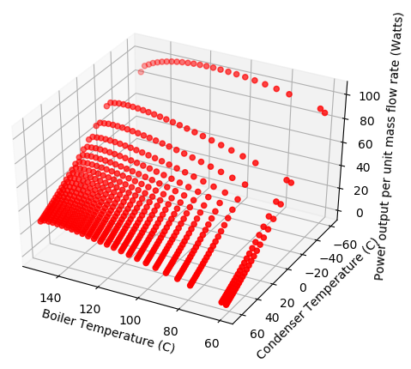
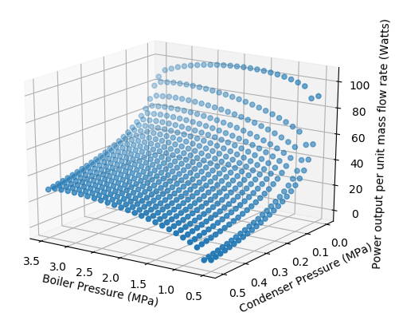
Working pressure and temperature preliminary results

Slide 27
Outline
Waste heat recovery
Sources
Recovery techniques
Technical hurdles
Thermodynamic cycles
Rankine cycle
Organic Rankine cycle
Kalina cycle
Automotive application
Special design considerations
Heat sources
Iterative design
Cycle parameters
Design space
Mathematical modelling
Optimization
Results
Design specifications
Assumptions
Discussion
Conclusion

Slide 28
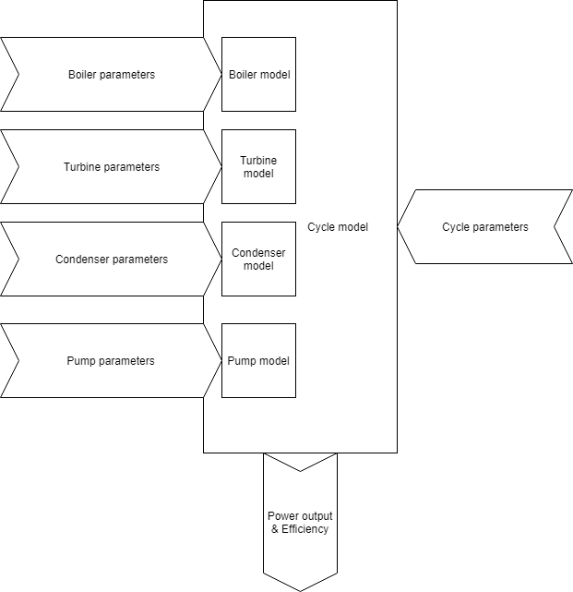
Proposed modelling

Slide 29
Outline
Waste heat recovery
Sources
Recovery techniques
Technical hurdles
Thermodynamic cycles
Rankine cycle
Organic Rankine cycle
Kalina cycle
Automotive application
Special design considerations
Heat sources
Iterative design
Cycle parameters
Design space
Mathematical modelling
Optimization
Results
Design specifications
Assumptions
Discussion
Conclusion

Slide 30
Outline
Waste heat recovery
Sources
Recovery techniques
Technical hurdles
Thermodynamic cycles
Rankine cycle
Organic Rankine cycle
Kalina cycle
Automotive application
Special design considerations
Heat sources
Iterative design
Cycle parameters
Design space
Mathematical modelling
Optimization
Results
Design specifications
Assumptions
Discussion
Conclusion

Slide 31
Design specifications
The results of optimizing the mathematical model will be used to inform the design specifications for prototyping and iterative design

Slide 32
Outline
Waste heat recovery
Sources
Recovery techniques
Technical hurdles
Thermodynamic cycles
Rankine cycle
Organic Rankine cycle
Kalina cycle
Automotive application
Special design considerations
Heat sources
Iterative design
Cycle parameters
Design space
Mathematical modelling
Optimization
Results
Design specifications
Assumptions
Discussion
Conclusion

Slide 33
Assumptions
Test assumptions made in the mathematical model
Depending on the outcomes adjustments should be made to results

Slide 34
Outline
Waste heat recovery
Sources
Recovery techniques
Technical hurdles
Thermodynamic cycles
Rankine cycle
Organic Rankine cycle
Kalina cycle
Automotive application
Special design considerations
Heat sources
Iterative design
Cycle parameters
Design space
Mathematical modelling
Optimization
Results
Design specifications
Assumptions
Discussion
Conclusion

Slide 35
Discussion
For the purpose of gaining my MSE, there will be further discussion of the model, assumptions and results. This discussion will layout future work plans, optimizations to the work performed here, and explanations of what was completed as required.

Slide 36
Outline
Waste heat recovery
Sources
Recovery techniques
Technical hurdles
Thermodynamic cycles
Rankine cycle
Organic Rankine cycle
Kalina cycle
Automotive application
Special design considerations
Heat sources
Iterative design
Cycle parameters
Design space
Mathematical modelling
Optimization
Results
Design specifications
Assumptions
Discussion
Conclusion

Slide 37
Questions?

